Slide 1
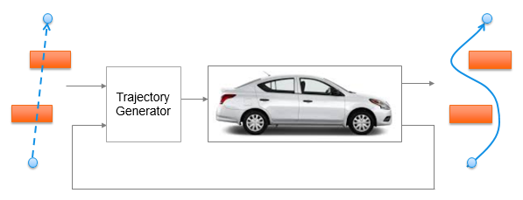
Trajectory Generation in High Density Environment
Final Review
Suvo Ganguli
Alberto Speranzon
July, 2018

Slide 2
Agenda
Project Overview – 1 min
Summary of Accomplishments – 15 min
Future Work – 1 min
Q&A – 3 min
Honeywell Internal
Honeywell Internal
Notes:
Honeywell Internal
<number>

Slide 3
Project Overview
Project Summary
PI: Suvo Ganguli, Alberto Speranzon
RTC: CNS
Project Name: Trajectory Generation in High Density Environment
Budget: 75K
Problem Statement/Objective:
Trajectory generation in cluttered environment is a key problem to solve for autonomous operations
The goal of this project is to understand the trade-offs between the different parameters used to design trajectory generation in presence of obstacles
Deliverables
Mid Term
Developed 2D trajectory generation algorithm
Design trade-off studies
End Term
Algorithm for avoiding pop-up obstacles
Alternate 2D trajectory generation software without using costly / time-consuming global planner
Comparative and robustness studies
Project Status
YTD Spend: 75K
WORK Complete: 100%
Honeywell Internal
Notes:
Honeywell Internal
<number>

Slide 4
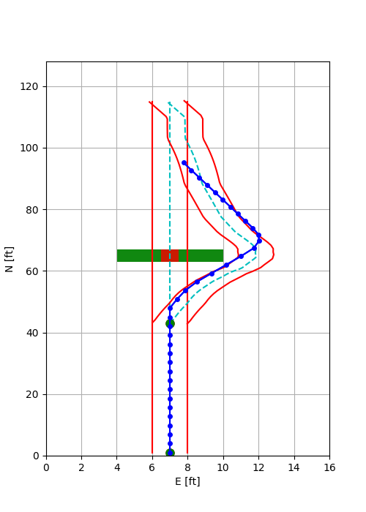
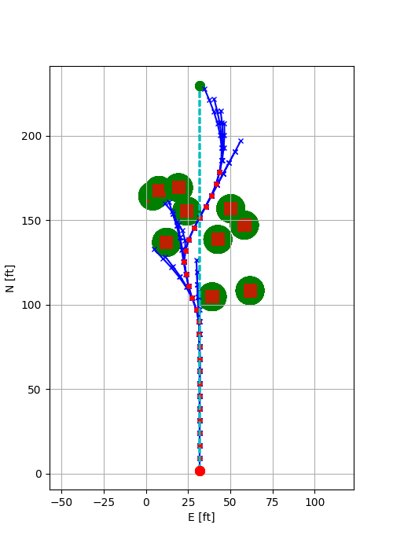
Summary of Accomplishments
Laplacian – computed using overall potential flow
MPC – computed by projecting trajectory a few time steps ahead
taking into account the vehicle dynamics
Developed two algorithms for obstacle avoidance using
Laplacian + MPC (LMPC)
MPC
Advantage of MPC Trajectory Generator
Avoids re-computation of initial trajectory using costly / time-consuming global Laplacian planner, upon encountering pop-up obstacles
Performed design trade-off studies (mid-term)
Performed comparative study showing 2X to 3X reduction in computation time using MPC Trajectory Generator
Performed robustness study of MPC Trajectory Generator
Successfully generated trajectories for 99 out of 100 test cases with 10 randomly placed pop-up obstacles
Studied specific test cases to analyze occasional failure of MPC trajectory generator
Model predictive control
LMPC Trajectory Generation
MPC Trajectory Generation
Updated Laplacian Trajectory
MPC Trajectory
Pop-up obstacle
Initial Laplacian Trajectory
Final MPC Trajectory
Figure shows re-computation of Laplacian Planner trajectory after encountering a pop-up obstacle
Figure shows re-computation of MPC Planner trajectory after encountering pop-up obstacles
Honeywell Internal
Notes:
Honeywell Internal
<number>

Slide 5
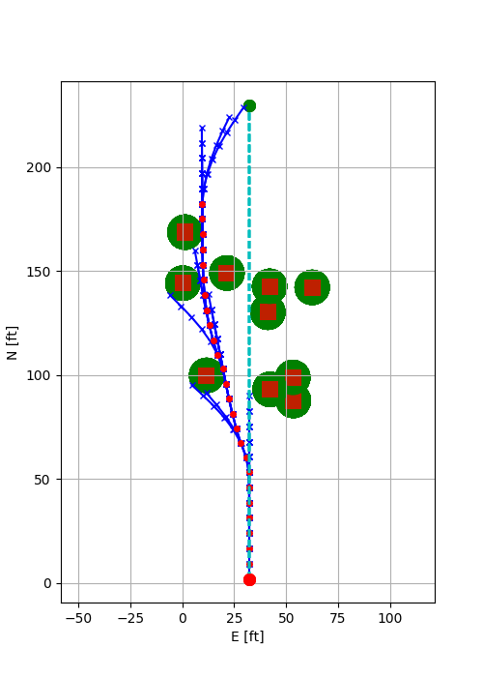
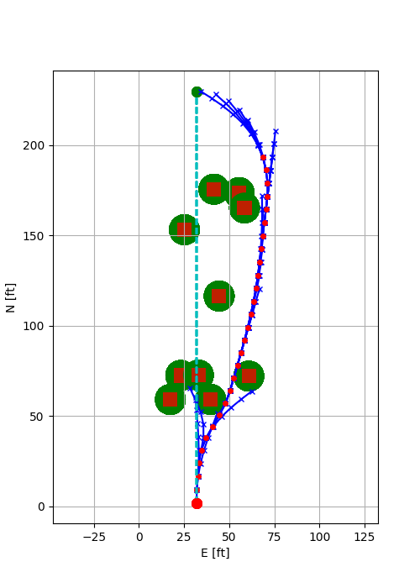
MPC Randomized Test Cases
MPC Trajectory Generator changes the heading of the path upon finding less “costly” path
MPC Trajectory Generator changes the heading of the path upon a “dead end”
Honeywell Internal
Notes:
Honeywell Internal
<number>

Slide 6
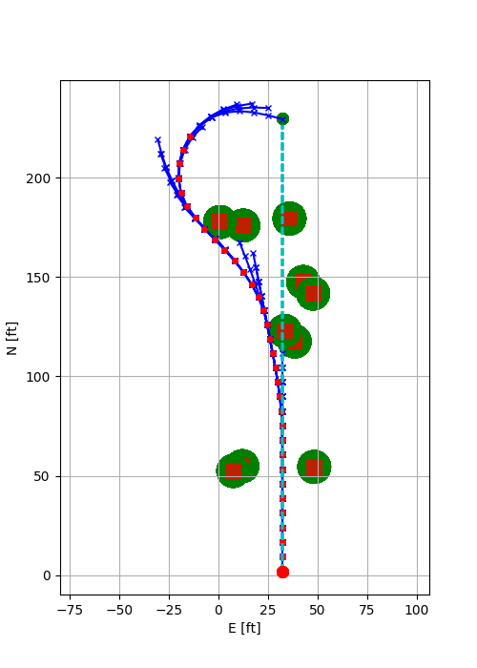
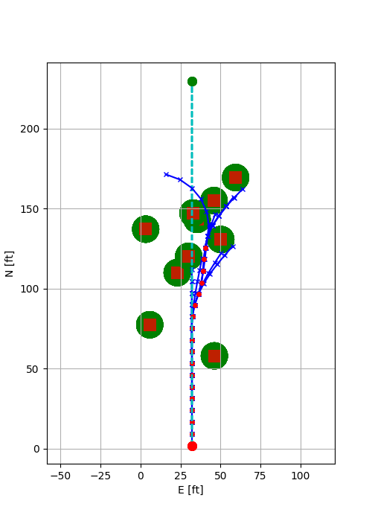
MPC Randomized Test Cases
MPC Trajectory Generator relative heading constraint is changed from 90 deg to 30 deg when no obstacles are in view
MPC Trajectory Generator is trapped and unable to progress farther
Honeywell Internal
Notes:
Honeywell Internal
<number>

Slide 7
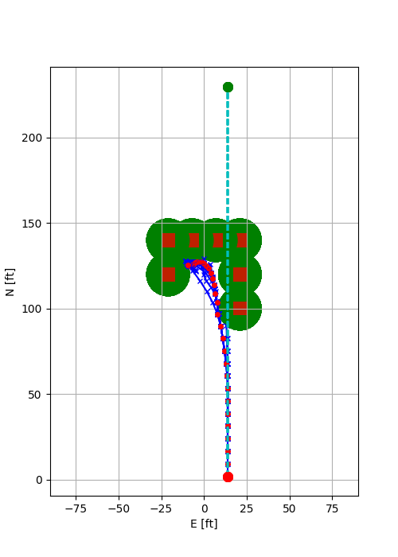
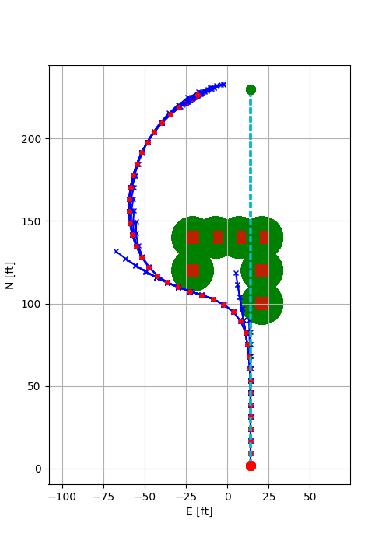
MPC Specific Test Cases
MPC Trajectory Generator is trapped and slows down to zero speed
MPC Trajectory Generator successfully reaches the end point with relaxed turn constraints
Honeywell Internal
Notes:
Honeywell Internal
<number>

Slide 8
Future Work
MPC Trajectory Generator solves a non-linear optimization problem which cannot guarantee a solution at every time step.
To obtained a guaranteed solution we will look at the following approaches:
Approximate optimization problem formulation using linearized vehicle dynamics and linear constraints
Modify problem formulation to allow velocity reversal
Continue on the MPC path computed in the previous time step and run a less costly global planner (e.g., Probabilistic Road Maps) to re-initialize the MPC problem
Current MPC trajectory generator is not optimized to run in real time
To obtain real-time performance we will look at the following approaches:
Use near-optimal values to reduce the number of iterations
Use efficient linear solvers which is used by the nonlinear optimizer
Honeywell Internal
Notes:
Honeywell Internal
<number>

Slide 9
Q&A
Honeywell Internal
Notes:
Honeywell Internal
<number>

Slide 10
Q&A
Honeywell Internal
Notes:
Honeywell Internal
<number>

Slide 11
Q&A
Honeywell Internal
Notes:
Honeywell Internal
<number>

Slide 12
Q&A
Honeywell Internal
Notes:
Honeywell Internal
<number>

